Slide 1

CPU Scheduling Algorithm Visualizer
An Operating System(SE) Project
Presented by: Somil, Pratham, Khushi, Dikshant
Under the guidance of: Dr. Ankit Tomar

Slide 2

Objective
The objective of the project includes:
To develop a website that visually demonstrates how different CPU scheduling algorithms operate.
To help users understand and compare the execution of:
FCFS (First Come First Serve)
SJF (Shortest Job First)
Round Robin
Priority Scheduling
To visualize outputs such as Gantt Charts, average waiting time, and turnaround time in real time.
To enhance the practical understanding of CPU scheduling techniques taught in Operating Systems.

Slide 3

Technology Stack
This project leverages web technologies to create an interactive CPU scheduling visualizer, enabling users to simulate and compare different scheduling algorithms in real-time.
Frontend:
HTML5: Structures the layout of the web page.
CSS3 / Tailwind CSS: Handles styling and responsive design.
JavaScript (Vanilla or React.js): Manages dynamic interactions and user inputs.
Scheduling Logic Implementation:
Implemented using pure JavaScript
Handles core logic for: FCFS, SJF, Round Robin, and Priority Scheduling
Development Tools:
Visual Studio Code (VS Code) for coding and debugging.
Git for version control and backup.

Slide 4

Project Idea/ Overview
The CPU Scheduling Algorithm Visualizer is a web-based platform that allows users to interactively explore and understand the working of various CPU scheduling algorithms. It is designed to make the learning process of Operating Systems concepts more engaging and easier to grasp by providing real-time visualizations and calculated results.
The website will allow users to simulate different CPU scheduling algorithms, such as First-Come, First-Served (FCFS), Shortest Job First (SJF), Round Robin (RR), and Priority Scheduling. Users can input details like process arrival time, burst time, and priority, and see how the algorithms schedule the processes step by step.

Slide 5

Workflow/ Architecture
The architecture of the CPU Scheduling Algorithm Visualizer is designed to provide a seamless user experience while executing scheduling algorithms and displaying real-time results.
The workflow is as follows:
Users enter process details (arrival time, burst time, priority, time quantum).
Users select a CPU scheduling algorithm (FCFS, SJF, Round Robin, Priority Scheduling).
The algorithm is executed, calculating waiting time, turnaround time, and response time.
A Gantt Chart is generated, displaying the execution order and performance metrics are displayed

Slide 6
Working
Our web-based CPU Scheduling Visualizer operates in a user-friendly and
dynamic manner. The working process is demonstrated below using screenshots:
Step 1: Input Form
Step 2: Algorithm Selection
Step 3: Click 'Calculate
Step 4: Output Display
Also ,user can compare the algorithms with each other.

Slide 7
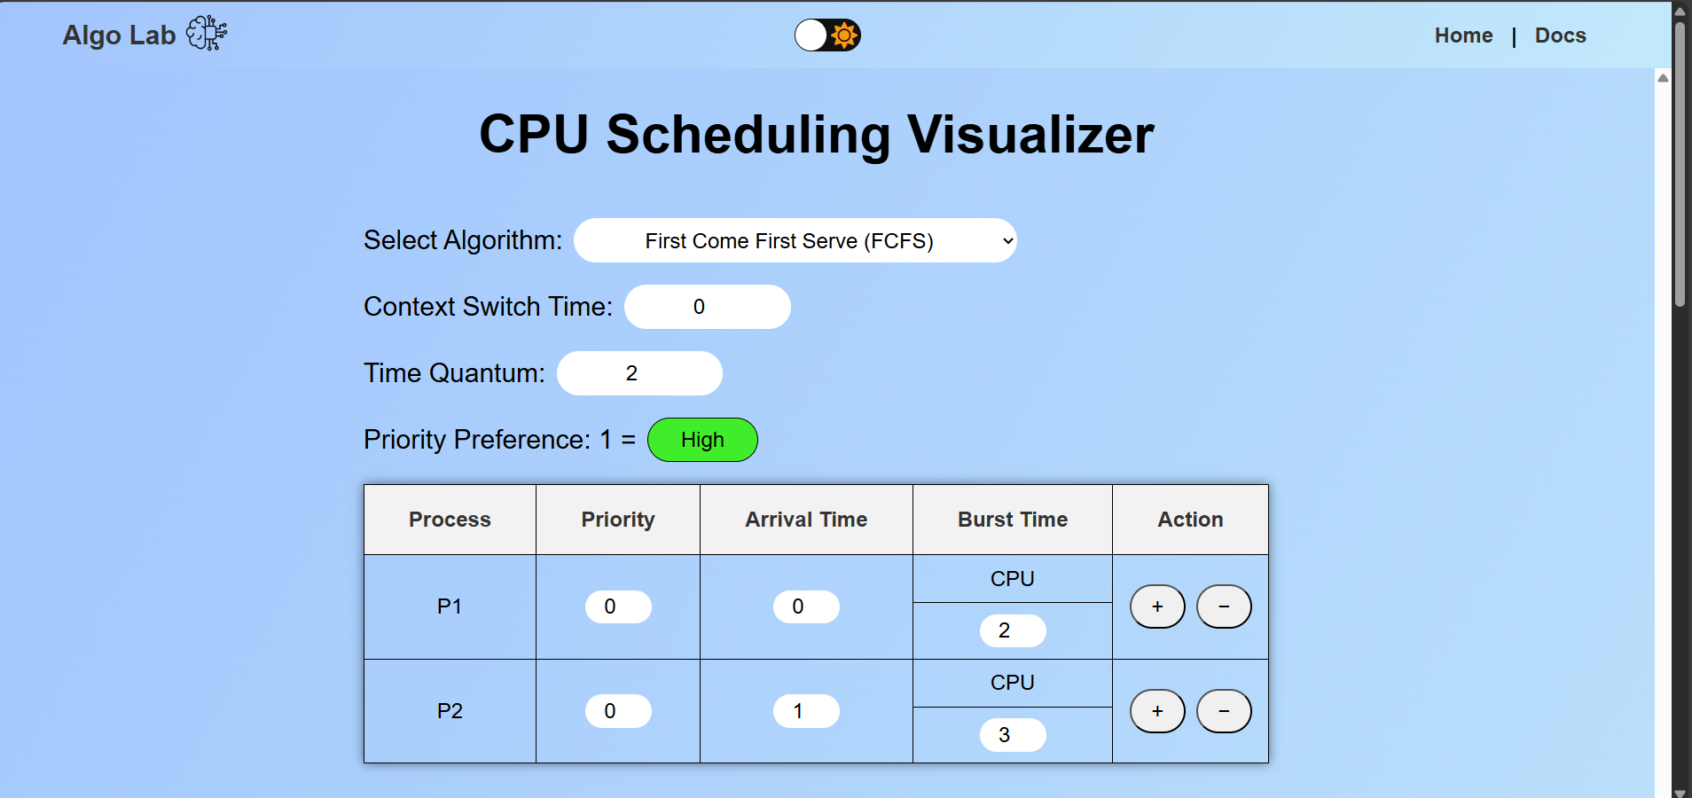
Working (CONTD.)

Slide 8
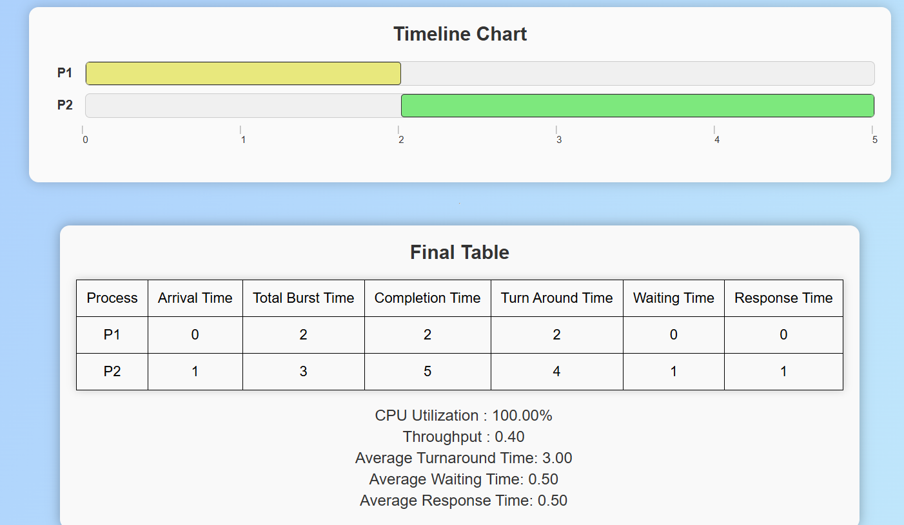
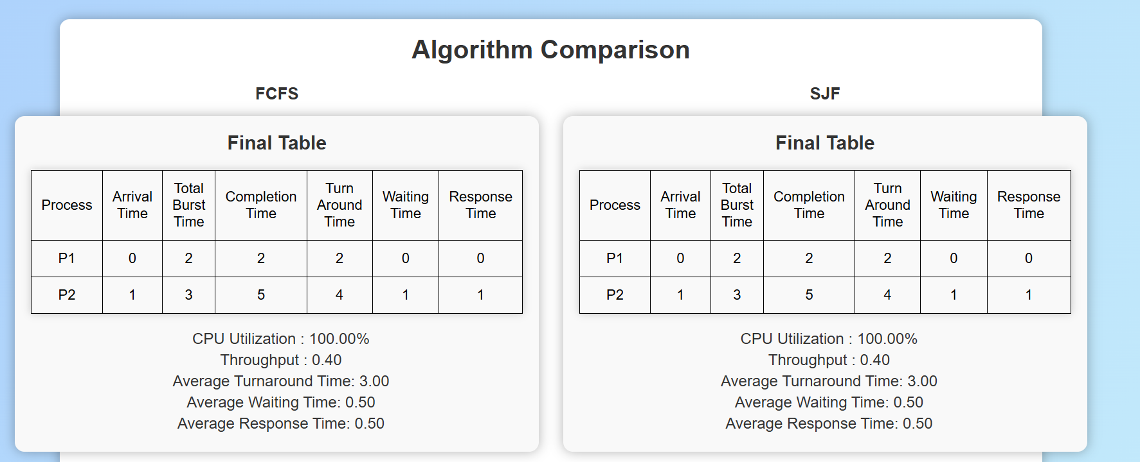
Working (CONTD.)

Slide 9

Roles & Responsibilities Of Each Member
Somil Negi – Team Lead & Front End Developer
Managed overall project development and timeline coordination.
Designed and implemented the user interface for intuitive interaction.
Pratham Singh & Khushi – Algorithm Implementation & Logic Development
Developed scheduling algorithms (FCFS, SJF, Round Robin, Priority Scheduling) using JavaScript.
Ensured accurate execution order and real-time performance metrics calculations.
Dikshant Singh Chib – UI Designer & Front End Developer
Designed the user interface to ensure it’s clean, intuitive, and responsive.
Implemented styling using CSS and java for modern, responsive design.

